Slide 1
Budget Proposal – Budget Committee
May 5, 2015

Slide 2
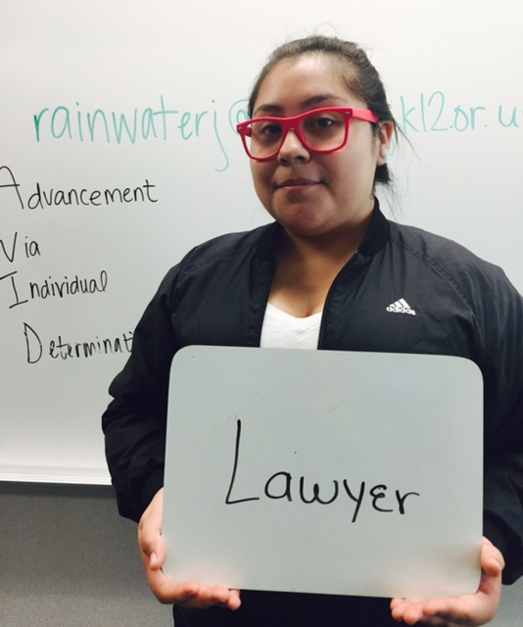
Newberg School District Students will graduate with the knowledge and skills needed to be successful, contributing citizens of the 21st Century.

Slide 3
Role of the
Budget Committee
Receive the budget message and the budget document
Ask questions about budget recommendations
Consider reasonableness of budget prepared
Make recommendations to the School Board to approve the budget from a citizen/community perspective

Slide 4
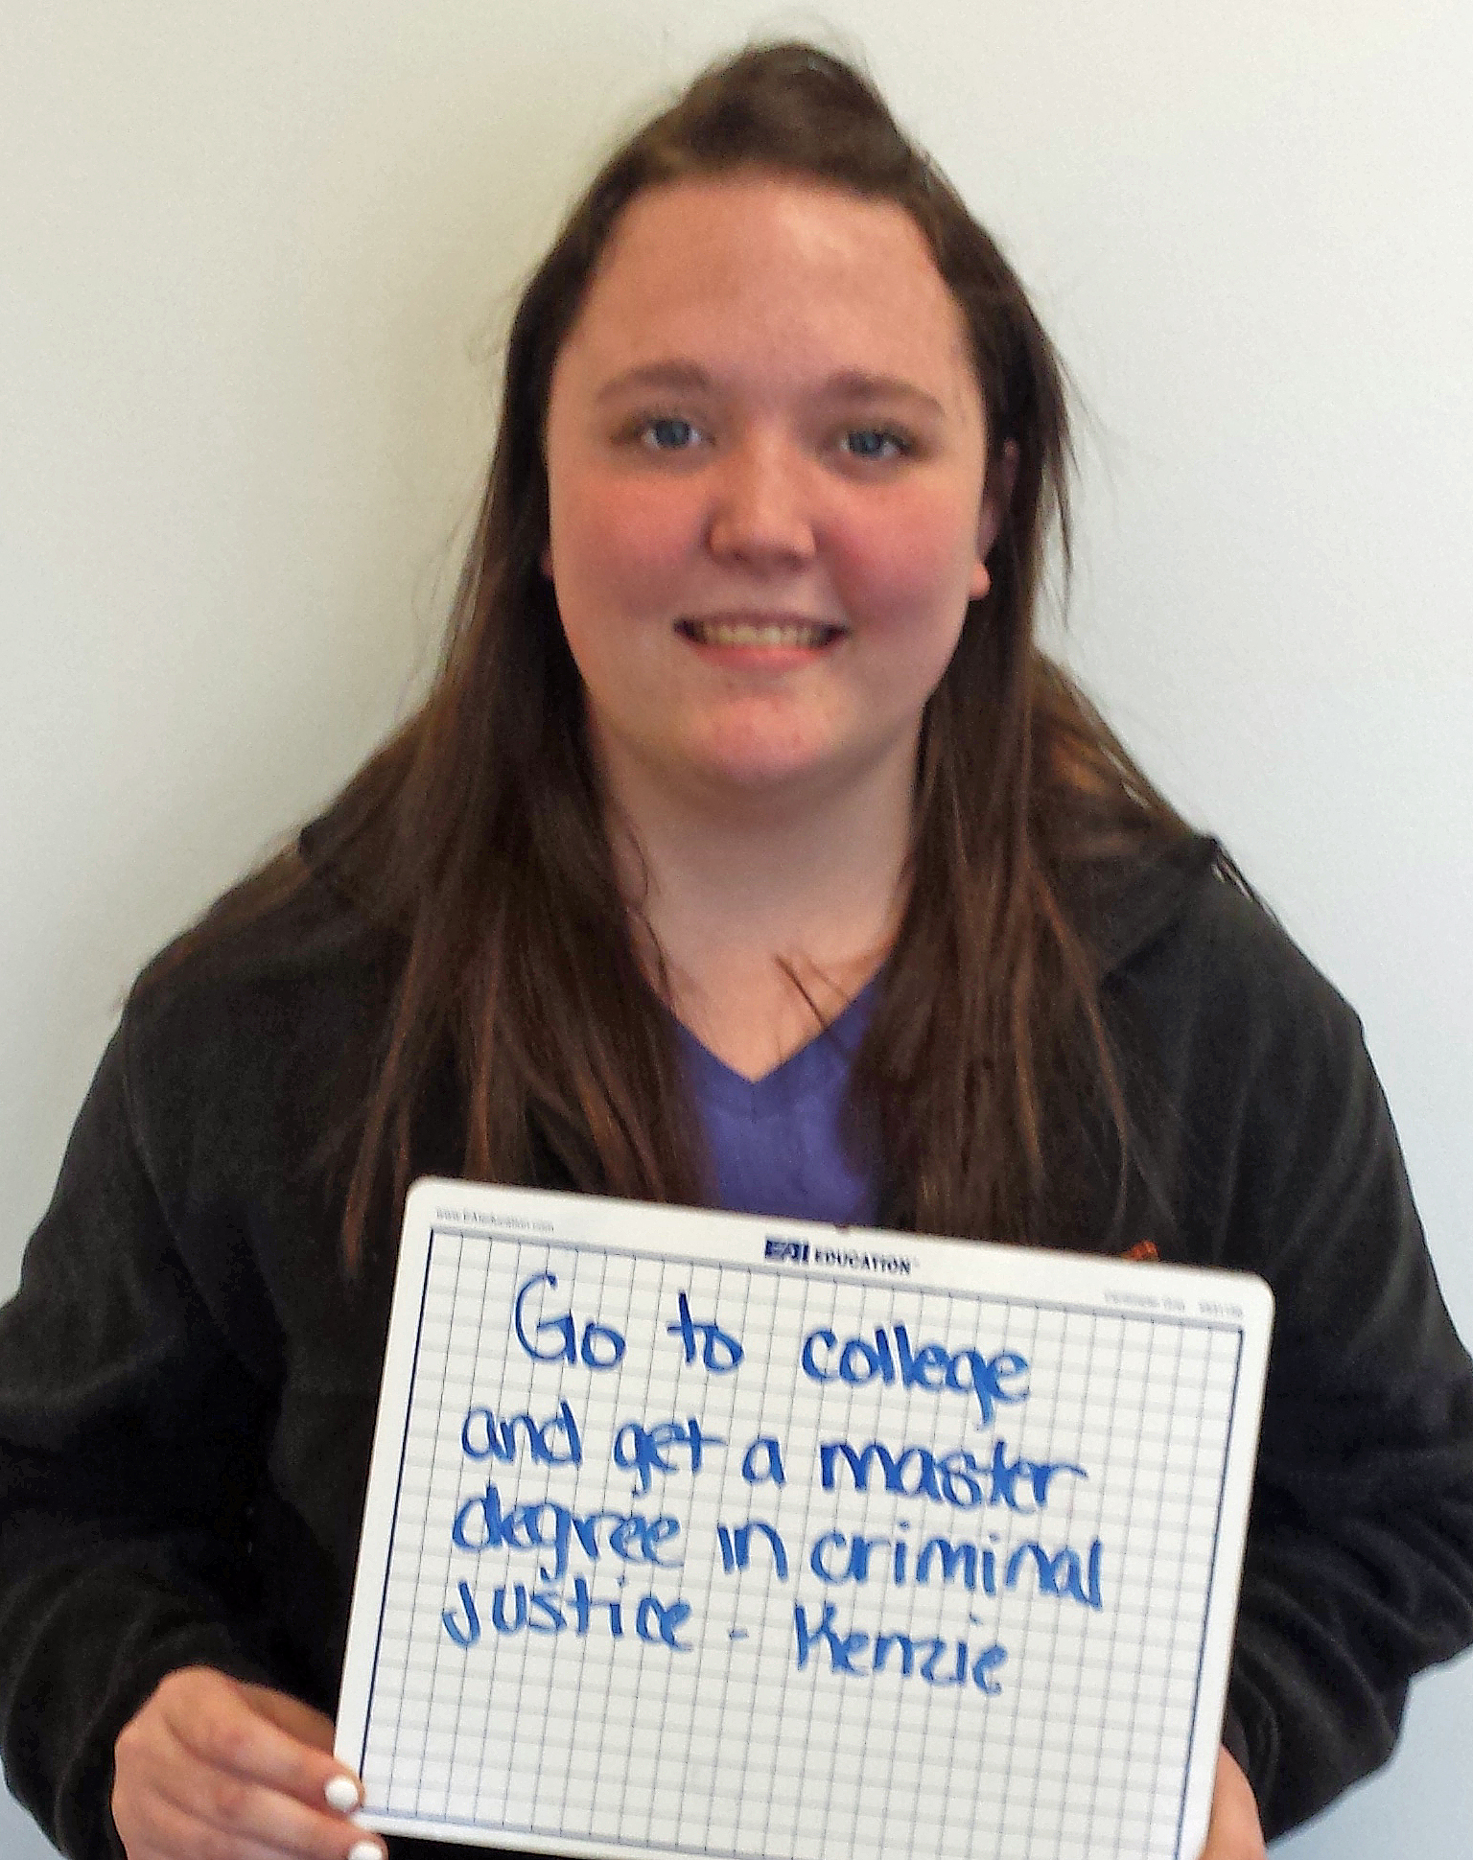
What makes up the
Newberg budget?

Slide 5
State Revenue Forecast
State Budgeting funding: $7.255 billion ($6.65B last biennium)
In December 2014, Oregon was sixth in the nation for job growth
Personal income is expected to increase by 5-6% each year over the next two years
Growth projections between 2010 - 2020:
Oregon population growth is 1.03%
K-12 population growth is 1.5%
Age 65+ population growth is 48%

Slide 6
Change in State
General Fund and
Lottery Spending

Slide 7
What did we accomplish
in 2014-15?
To advance the district’s strategic priorities this year, remaining bond funds and approximately $616,000 in grant dollars were leveraged to provide:
Expanded career and technical education opportunities for secondary students
Professional learning to teachers and school administrators to address achievement gaps for ELL students
Kindergarten readiness and early learning opportunities
New assessment tools for educators
Leadership to advance teaching and learning, instructional technology, school-to-business partnerships and STEM education
Technology for students and a more robust, secure infrastructure
Streamlined communication systems to better connect school and home

Slide 8
General Fund Impact 2014-15
Before any dollars were directed to district priorities, the 2014-15 school district budget provided funds to:
Restore budgets previously supported by the bond
Establish a contingency fund
Provide employee salary increases
Increase elementary staffing

Slide 9
Budget Restorations 2010-14
Budget decisions in 2010-2014 restored nearly all
the staffing, school days and programs that were
part of reductions during the economic downturn
five calendar days
class size
Welcome Center staff
extra-duty stipends
campus monitor staff
teaching & learning leadership and budget for professional development
HVAC staff
technology staff
increases in school budgets

Slide 10
Goals for 2015-16
Align the Newberg School District budget to priorities and goals
with the Strategic Plan

Slide 11
Strategic Plan Priorities
Provide a high-quality, well rounded and healthy educational experience to all students that is engaging, rigorous and culturally relevant
Build strong relationships with families, community and students to promote trust, support and collective responsibility for student success.
Ensure that every classroom has a high-quality, effective educator supported by strong leadership and staff.
Align resources to accomplish goals within a balanced budget.
Plan systemically and strategically so that the Newberg School District continues to succeed and thrive into the future

Slide 12
40 - 40 - 20
40% College diploma
40% Community college, trade, CTE degree
20% High school diploma
TOTAL: 100% high school graduation

Slide 13
Newberg School District
76.6% graduation rate
46% poverty
87% of 11th graders passed OAKS reading, 75% math
94% attendance rate
Elementary class size 1:25; secondary 1:26

Slide 14
2015-16 Budget
must support
our progress toward
21st Century
Teaching & Learning and ensure that
“All means All”

Slide 15
2015-16 Budget
ENDING Fund Balance 2014-15 is anticipated to be $1,030,000 (goal 3%-$1,445,165.)
In 2013-14 it was $729,000.

Slide 16
2015-16 Budget Assumptions
$48,172,190 compared to $45,358,713 ($2,813,477)
Employee Contracts anticipated cost approx. $1,218,000
Full day kindergarten staff changes $717,762
Increase school budgets $63,239
Professional Learning, subs and stipends for staff - $337,500
Re-fund musical instrument repair and replacement $25,000
Digital conversion year 1 costs $324,976
Custodial increase for OT hours $28,020
Overhead costs – utilities, transportation, property insurance etc. $81,000
STEM & CTE continued support $15,000
Association support $19,535
TOTAL $2,813,477

Slide 17
Budgeting a Biennium . . .
50/50 vs. 49/51
The difference in budgeting 50-50 versus 49-51
$577,170 into contingency

Slide 18
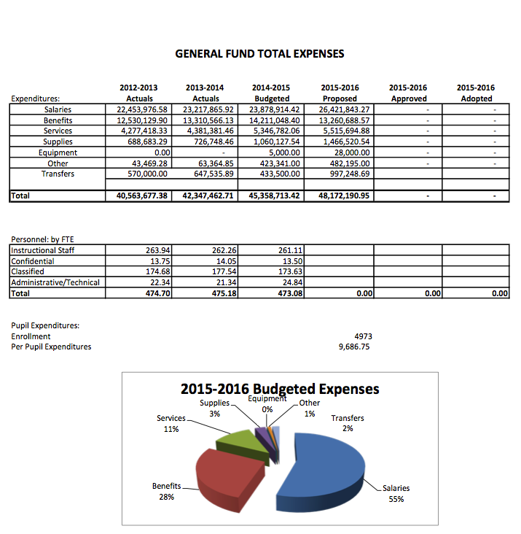
Big picture behind the numbers

Slide 19
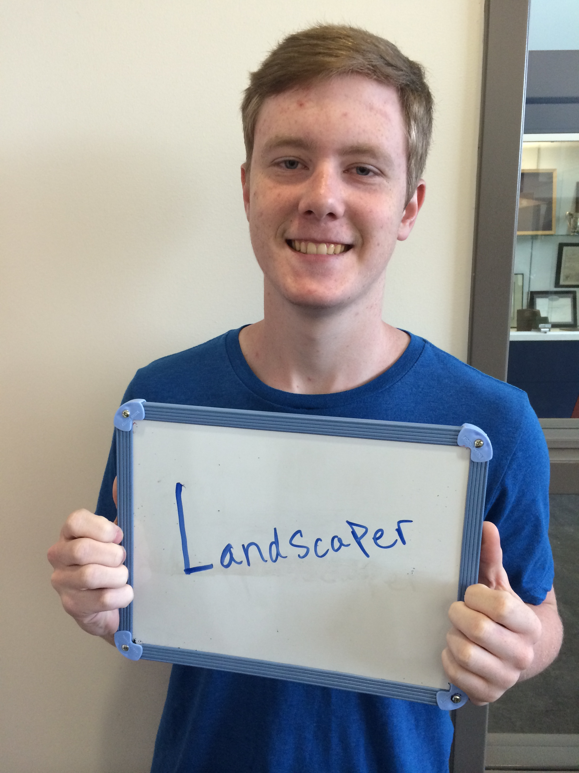
School Discretionary Budgets
Each school page indicates their entire cost including staffing as well as discretionary
Allocation per pupil from 2014-15 to 2015-16 increased by $12 per student
Range of per pupil spending was $4,983 to $6,954 YET overall average when all funds considered $9,686 per pupil. WHY? ALL staff are considered in formula for overall district: cafeteria, grounds, custodial, district staff etc.; federal funds for special needs students, Title, etc.

Slide 20
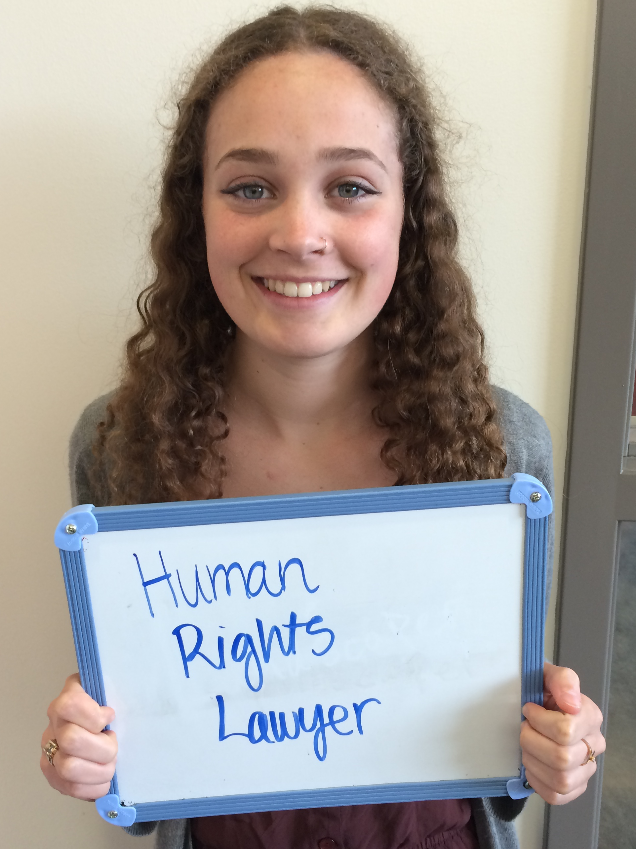
Other Factors that
Impact our Work
Enrollment in Newberg is flat. We have a pattern of decrease over the school year (-82.36 ADMw for 2015-16 – 5955.71)
PERS SB 822 overturned last week
Impact on Newberg School District still to be determined
Current savings we saw this year was approximately $1,000,000
Impact will be in 2017-19 biennium

Slide 21
Questions?

