Slide 1

Newberg High School
Financial Aid Night

Slide 2

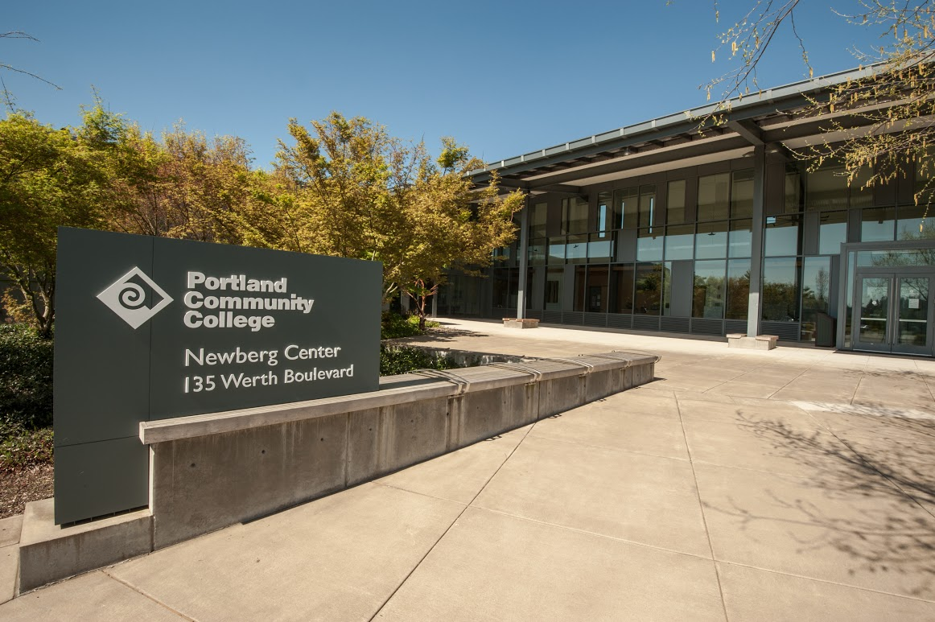
PCC Newberg Center
Begin your degree, explore, or get ready to transfer here in Newberg!

Slide 3

PCC Degrees
Associate of Applied Science
Associate of General Studies
Associate of Arts Oregon Transfer
Associate of Science
Associate of Science Oregon Transfer in Business

Slide 4
How much does it cost to go to PCC?
Tuition for residents is $97 per credit. Most classes are 1 to 4 credits each.
Example budgets for tuition, fees and books:
half time student (6 credits): about $825 per term
full time student (12 credits): about $1650 per term

Slide 5

Paying For College
The FAFSA
Oregon Promise
Scholarships

Slide 6

The FAFSA
Why do the FAFSA?
FAFSA application now opens October 1st

Slide 7

Oregon Promise
A grant program for students entering community college in fall 2016
To qualify, students must:
be recent high school graduates or have earned a GED
have at least a 2.5 high school GPA
have been Oregon residents for a year
enroll at least half time at a community college within six months of graduation
Funding for 2017-18 is subject to Oregon Legislative approval

Slide 8

Scholarships at PCC
Scholarships can help fund your college tuition, fees and books
Scholarships are different from financial aid, with a separate application
Scholarships are based on academic merit, financial need, and personal attributes

Slide 9
Thanks for listening!
Teresa Salinas
tsalinas@pcc.edu
971-722-8521
Sarah Elsasser
sarah.elsasser@pcc.edu
971-722-8611

